Slide 1
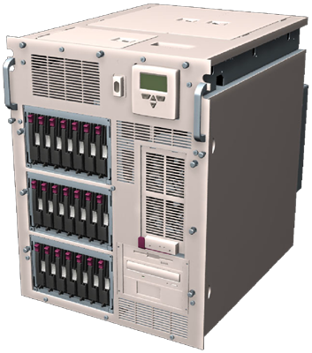
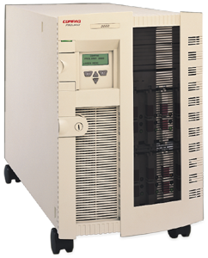
Customer: Marks and Spencer
Business Challenges
Lack of detail in summarized sales receipt batches
Sales information flowing too slowly to back-end systems and supply chain partners
Fragmented infrastructure made information sharing difficult
Business Benefits
Near real-time sales information flowing to back end
Sales detail allowing sales detail and trend insight
Integrated system allowing sales receipts, promotions, and replenishment orders to flow over same infrastructure
Headquarters
Store
Sales Receipts
Store
Store
Store
Using BizTalk to move detailed sales data to corporate headquarters and integrate with
multiple back-end systems
Notes:
Marks and Spencer is a $13billion organization based in the UK. They have roughly 600 stores, 500 of which are company owned. Their corporate systems and network currently allows them to upload summarized sales data nightly from each of those stores. During that following day, the data is analyzed, and considerations can be made for changes to their store assortment, offerings or promotions. Because of increasingly intense competitive pressures and their long-standing tradition of quality and customer service, the competitive bar has been raised for their infrastructure requirements.
Not only does information only flow nightly from each store to the corporate headquarters, but it is summarized at a fairly high level. The sales details that would allow them to have insight into correlative buying behavior is simply not possible. Also, it is impossible today for them to receive the data and seamlessly move it into all of the systems that would benefit from access to that data.
The decisions that are made as a result of analyzing that summarized data can only affect change in the stores normally 3-4 days after the activity itself, and then making those promotional or strategic changes in the stores is done through different processes instead of through messages flowing over the same infrastructure.
CASE STUDY COMING VERY SOON

Slide 2
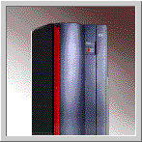
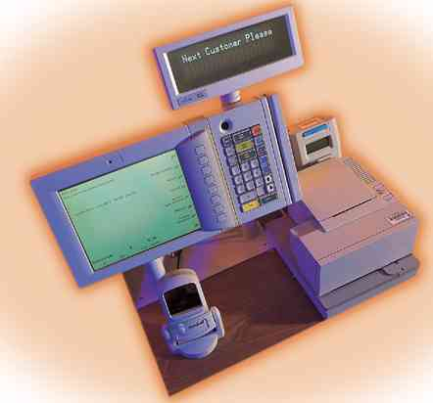

Marks and Spencer Project
Real-time store data transfer for POS transactions
Central Windows 2000 Environment
Central Systems
Store
data
MESSAGING HUB
BizTalk Server
MSMQ
Windows 2000
COM-TI
CICS
DB2
Database
data
XML
MSMQ/
MQ Series
Bridge
MQSeries
MSMQ
Model 204
APPLICATION
S/390 environment
POS Transactions
wrapped in XML
BizTalk
doc
BizTalk
doc
Message Routing
Message Transformation
Message Dependent Processing
MSMQ
MSMQ
SQL
Database
NT Environment
Notes:
They have installed a single NT server in each store, with POS terminals all running NTW. Each transaction flows to the back end server, which batches the transactions every minute, converts them to XML using simple XML tools, and sends them to the corporate systems over MSMQ. At corporate, a load-balanced array of BizTalk Servers running Windows2000 receives those transmissions, then intelligently routs the right information, in the right format, over the right transport to all of the backend applications that must process and consolidate that data.
First, a subset of the sales detail is filtered by BizTalk Server out for all transactions that were processed by holders of Marks and Spencer credit cards. That data is transformed by BizTalk Server, and then sent to a CICS application on an IBM mainframe running against the DB2 database over Microsoft’s COM-TI technology.
Second, a separate subset of the data is extracted and transformed by BizTalk Server, then sent on to another application within the mainframe environment over MQSeries, this time utilizing an integrated MSMQ/MQSeries bridge provided by Microsoft.
Third, the entire set of data is transformed and sent over MSMQ to a back-end application on Windows2000 using the SQL7 database, which then rolls up the data into cubes for analysis using the integrated OLAP technology inclueded with SQL Server7.
As a result, far more detailed information is flowing far more quickly all the way to the back end systems that must support the stores, so that they can notice challenges, analyze trends, and ultimately manage promotions and affect change far more quickly in the stores in order to reduce costs and increase customer service.

